Slide 1
CS2106 Tutorial 11
File System

Slide 2
Q1
Putting it together

Slide 3
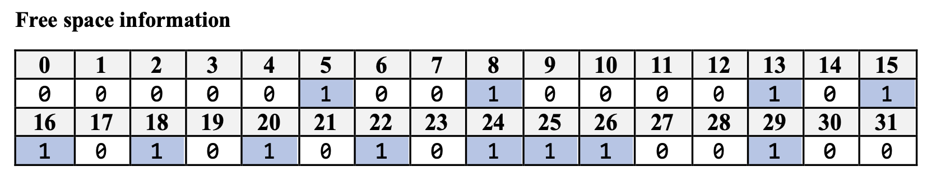
Q1a
Give: The current free capacity of the disk.

Slide 4
Q1a
Give: The current free capacity of the disk.
The current free capacity of the disk: ~12KB free space
Twelve '1's in Bitmap.
Each data block is 1KB.
Due to the linked list file allocation overhead, the actual capacity is a little bit smaller.

Slide 5
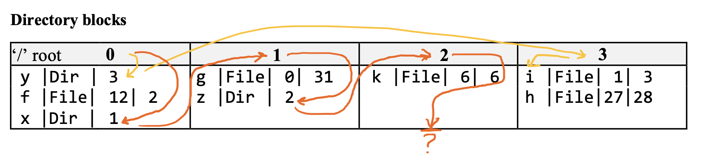
Q1a
Give: The current user view of the directory structure.

Slide 6
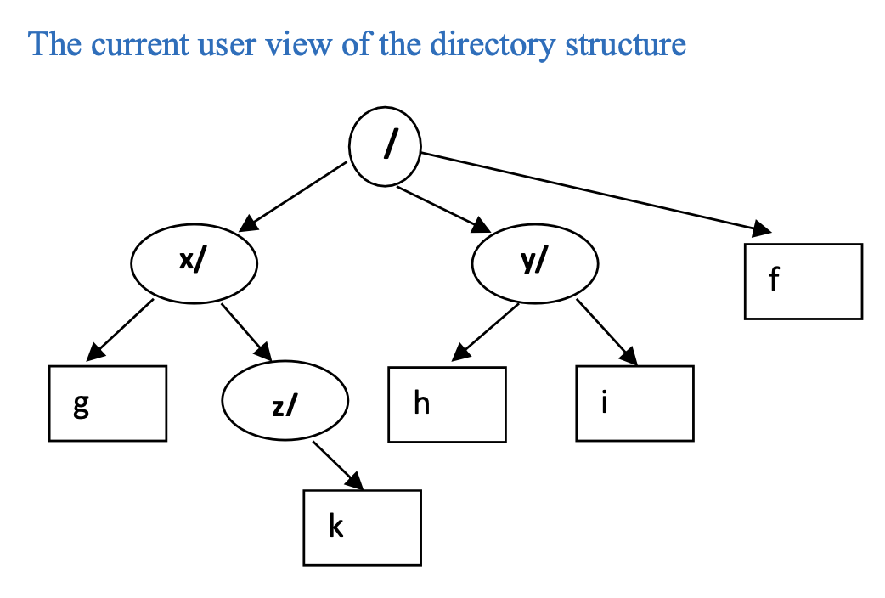

Q1a
Give: The current user view of the directory structure.

Slide 7
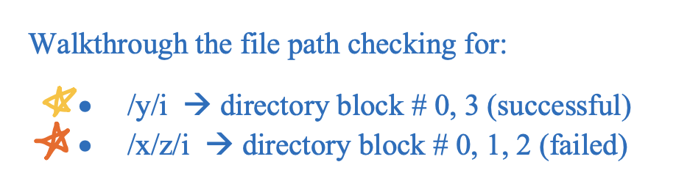
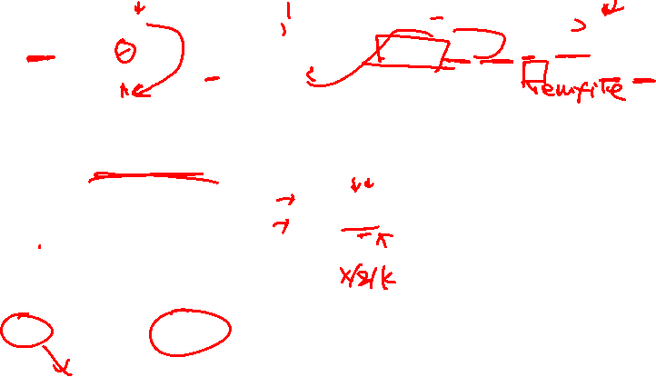
Q1b

Slide 8
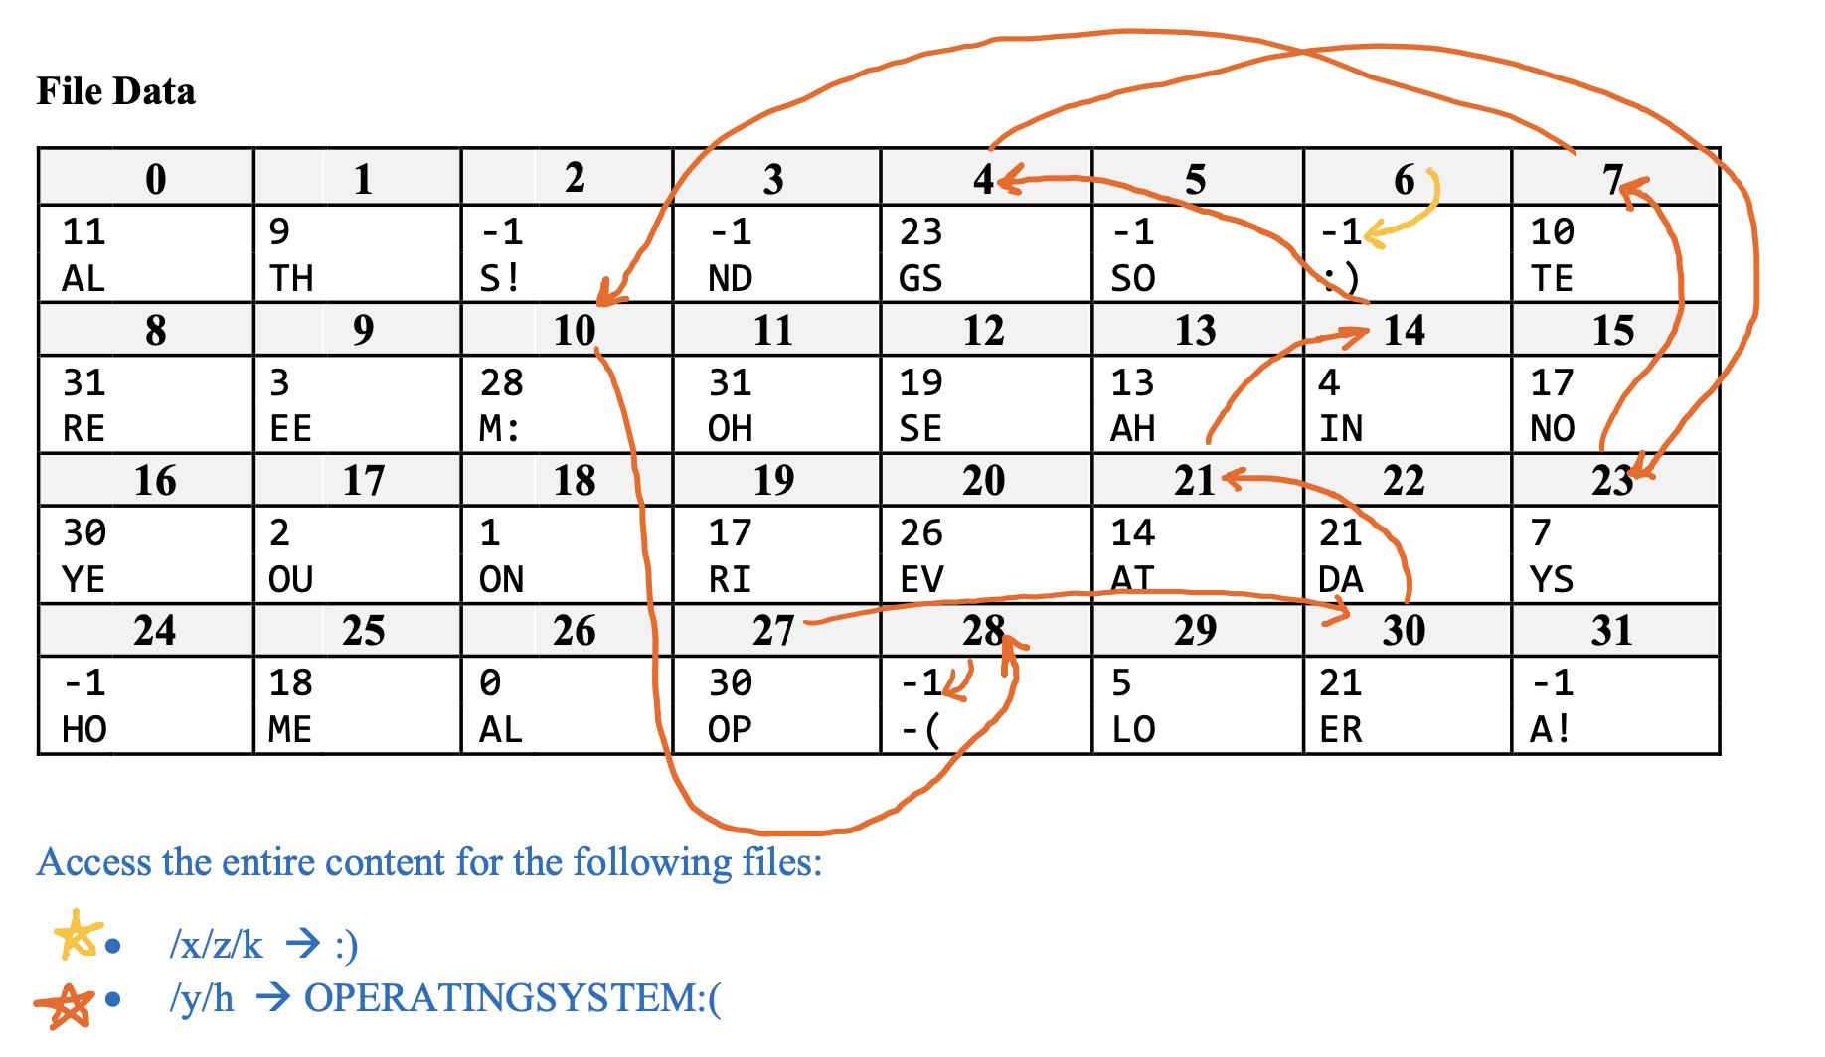
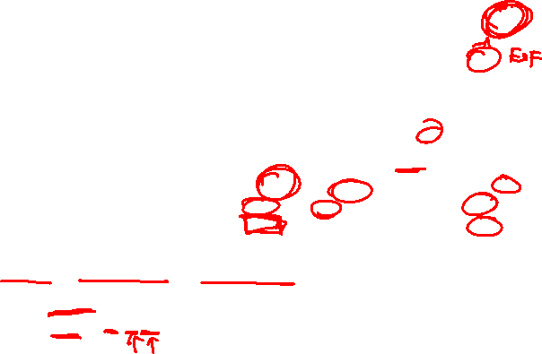
Q1c

Slide 9
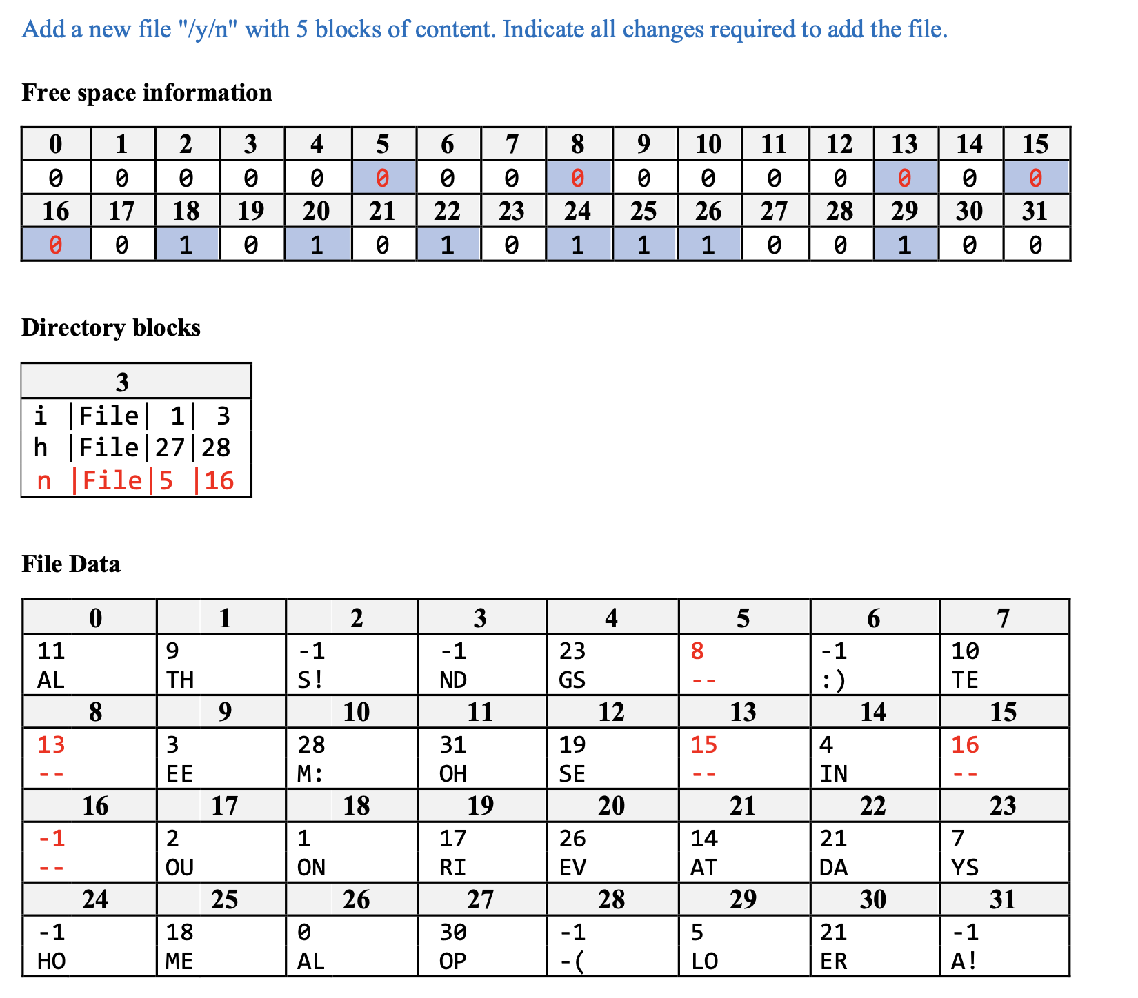
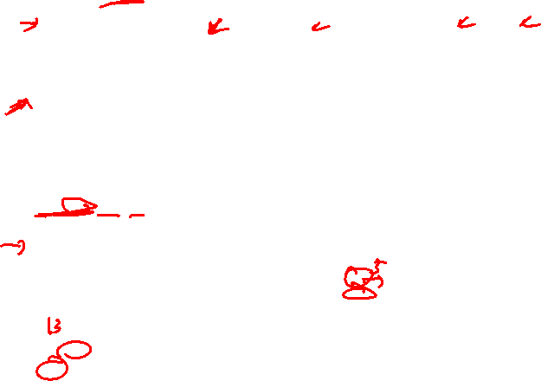
Q1d

Slide 10
Q2
File System Overhead

Slide 11

Q2
Overhead of FAT16 and ext2 file systems. To have a meaningful comparison, we assume that there is a total of 2¹⁶ 1KB data blocks.
Total space = 2¹⁶ x 2¹⁰ B
Overhead in FAT16 with two copies of File Allocation Table

Slide 12
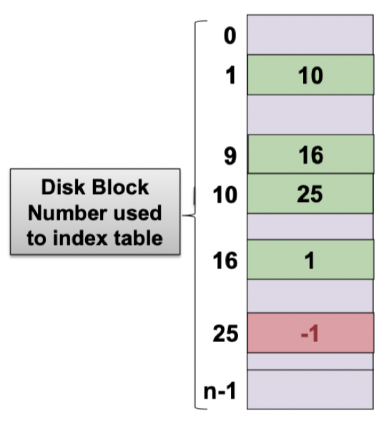

Q2
Overhead of FAT16 and ext2 file systems. To have a meaningful comparison, we assume that there is a total of 2¹⁶ 1KB data blocks.
Total space = 2¹⁶ x 2¹⁰ B
Overhead in FAT16 with two copies of File Allocation Table
Each FAT table is 2¹⁶ x 16 bit (2 bytes) = 2¹⁷ bytes.
2 copies of FAT table = 2 x 2¹⁷ = 2¹⁸ bytes. This takes 2¹⁸ / 2¹⁰ = 2⁸ disk blocks.
Note that due to the special codes (free, bad, eof etc), this setup handles less than 2¹⁶ data blocks. We ignore this fact for ease of comparison.

Slide 13
Q2
Overhead of FAT16 and ext2 file systems. To have a meaningful comparison, we assume that there is a total of 2¹⁶ 1KB data blocks.
Total space = 2¹⁶ x 2¹⁰ B
The two bitmaps (data block and inode) each occupies a single disk block.
184 inodes per block group
Overhead in ext2 (ignore the super block and group descriptors)

Slide 14
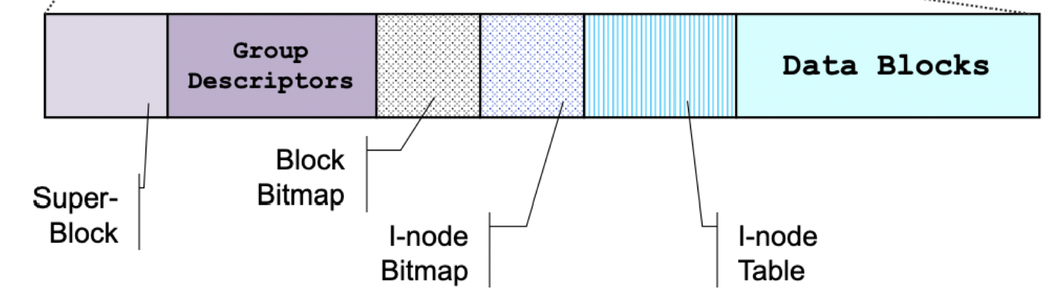




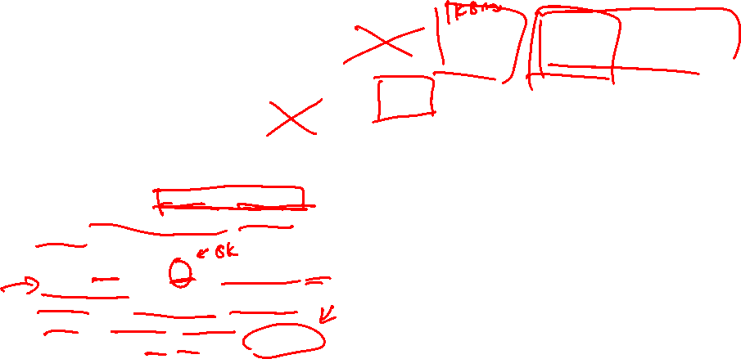
Q2
Each bitmap is in a 1KB block→ 8K bits → 8K data blocks per block group.
From restrictions, 184 inode x 128 bytes each / 1024 bytes data block = 23 disk blocks. Note that 184 inodes per block group is an arbitrary number.
From (i) 2¹⁶ blocks / 2¹³ per block group = 8 block groups.
Overhead per block group = 2 blocks of bitmaps + 23 blocks of inodes = 25 blocks.
Total overhead = 8 x 25 blocks = 200 blocks.
1KB = 8K bits
184 nodes x 128 bytes / node
= 23552 bytes
= 23552 bytes / (1024 bytes/blk)
= 23 disk blocks
each bit represents if a data block is occupied
so 8k = 2³ x 2¹⁰ = 2¹³ data blocks per group

Slide 15
Q2
Comment on the runtime overhead of the two file systems, i.e. how much memory space is needed to support file system operations during runtime.
FAT: The entire FAT table is in memory, i.e. 2¹⁷ bytes.
Ext2: Nothing is needed. Though for efficiency, a couple of the recently accessed I-Node may be cached. As a comparison, with the overhead of FAT, we can cache 2¹⁷/ 128 bytes = 2¹⁰ I-node in memory.

Slide 16
Q3

Slide 17

Q3a
Implement and optimize the storage and search of multiple fixed file sizes of 1MB. Each file has a unique numeric identifier, and it is saved on disk using ext2 file system.
The number of files is unlimited (say, 10 million), but it cannot grow beyond the disk size (maximum 10TB).
We want to optimize this file system to store and search fast for files by identifier.
You should use of some of the methods studies under file system implementation for your optimizations.
First, assume that all files are stored in a directory. What would be the main disadvantage when we want to add a new file? What would be the main disadvantage when searching for a file by identifier?

Slide 18
Q3a
Implement and optimize the storage and search of multiple fixed file sizes of 1MB. Each file has a unique numeric identifier, and it is saved on disk using ext2 file system.
The number of files is unlimited (say, 10 million), but it cannot grow beyond the disk size (maximum 10TB).
We want to optimize this file system to store and search fast for files by identifier.
You should use of some of the methods studies under file system implementation for your optimizations.
First, assume that all files are stored in a directory. What would be the main disadvantage when we want to add a new file? What would be the main disadvantage when searching for a file by identifier?
For storing a new file: need to traverse the whole directory (all DE in the linked list)
For searching, possibly need to search through the whole linked list.

Slide 19
Q3b
Implement and optimize the storage and search of multiple fixed file sizes of 1MB. Each file has a unique numeric identifier, and it is saved on disk using ext2 file system.
The number of files is unlimited (say, 10 million), but it cannot grow beyond the disk size (maximum 10TB).
We want to optimize this file system to store and search fast for files by identifier.
You should use of some of the methods studies under file system implementation for your optimizations.
Assume that you do not have any restrictions in terms how many directories you can use. How would you mitigate the disadvantages shown at point a. for storing a file? Explain your optimizations.

Slide 20
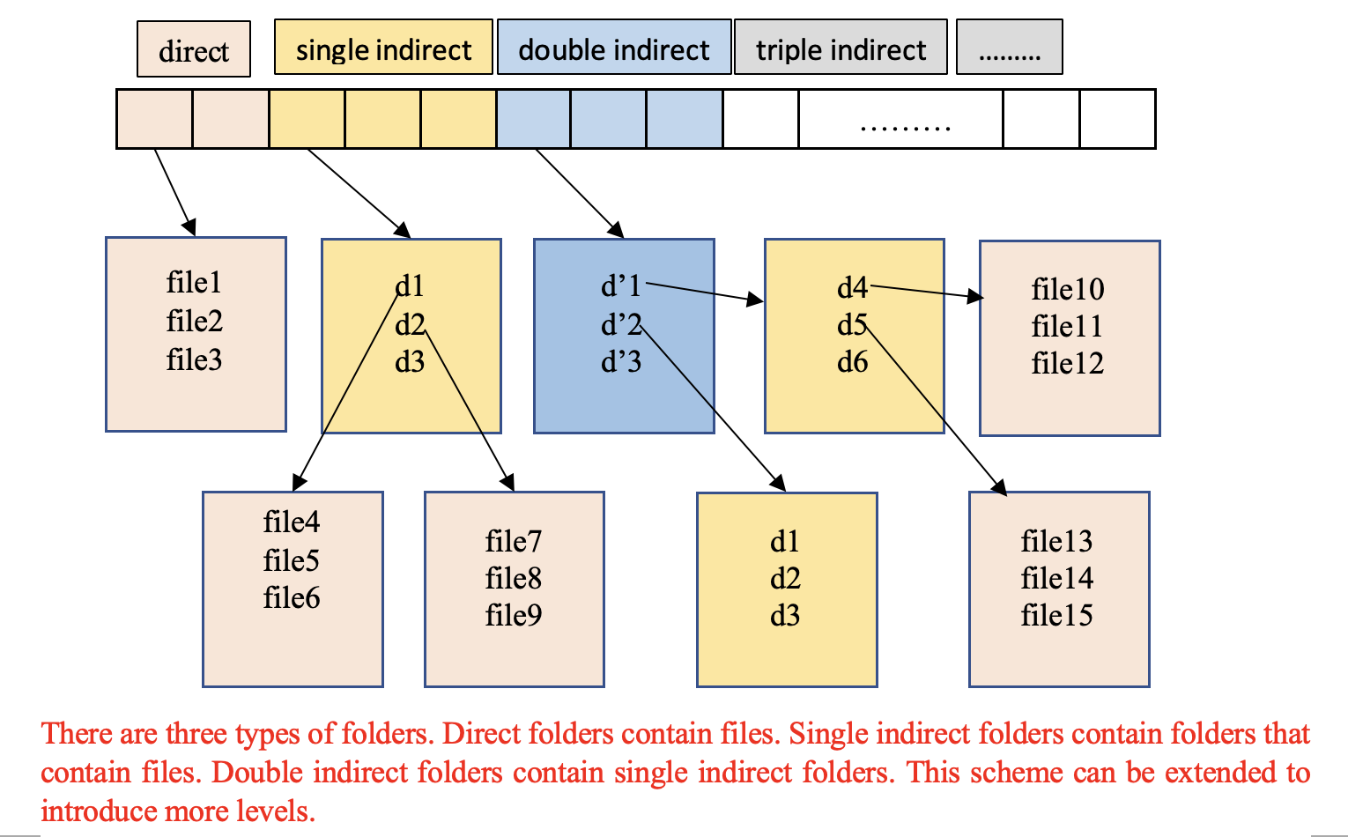
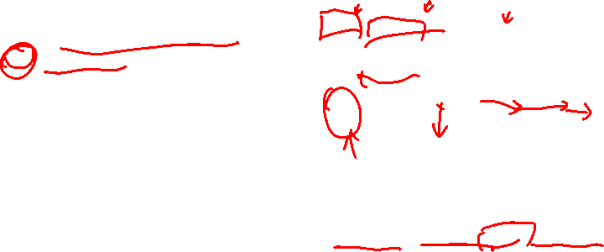
Q3b
Implement and optimize the storage and search of multiple fixed file sizes of 1MB. Each file has a unique numeric identifier, and it is saved on disk using ext2 file system.
The number of files is unlimited (say, 10 million), but it cannot grow beyond the disk size (maximum 10TB).
We want to optimize this file system to store and search fast for files by identifier.
You should use of some of the methods studies under file system implementation for your optimizations.
Assume that you do not have any restrictions in terms how many directories you can use. How would you mitigate the disadvantages shown at point a. for storing a file? Explain your optimizations.
Store a limited number of entries (X) in each directory. Use a hierarchical structure similar to what EXT2 is using. Shown is an illustration of an example hierarchical structure.

Slide 21
Q3c
Implement and optimize the storage and search of multiple fixed file sizes of 1MB. Each file has a unique numeric identifier, and it is saved on disk using ext2 file system.
The number of files is unlimited (say, 10 million), but it cannot grow beyond the disk size (maximum 10TB).
We want to optimize this file system to store and search fast for files by identifier.
You should use of some of the methods studies under file system implementation for your optimizations.
How would you mitigate the disadvantage(s) shown at point a. for searching a file by identifier? Explain your optimizations.

Slide 22
Q3c
Implement and optimize the storage and search of multiple fixed file sizes of 1MB. Each file has a unique numeric identifier, and it is saved on disk using ext2 file system.
The number of files is unlimited (say, 10 million), but it cannot grow beyond the disk size (maximum 10TB).
We want to optimize this file system to store and search fast for files by identifier.
You should use of some of the methods studies under file system implementation for your optimizations.
How would you mitigate the disadvantage(s) shown at point a. for searching a file by identifier? Explain your optimizations.
Use a hash table to map the file identifier to the directory in which it is located. The hash table can be stored in memory because its size is: #files * (file_id_size + pointer_to_directory_block). 10 million files would occupy only 160MiB of RAM. The idea is that the memory overhead of the hash table is affordable, thus this scheme is feasible.

Slide 23
Q3d
Implement and optimize the storage and search of multiple fixed file sizes of 1MB. Each file has a unique numeric identifier, and it is saved on disk using ext2 file system.
The number of files is unlimited (say, 10 million), but it cannot grow beyond the disk size (maximum 10TB).
We want to optimize this file system to store and search fast for files by identifier.
You should use of some of the methods studies under file system implementation for your optimizations.
You are allowed to use additional data structures to speed up the storing and searching of files. What data structures would you use to implement your optimizations? Be specific about what you store in each data structure.

Slide 24
Q3d
Implement and optimize the storage and search of multiple fixed file sizes of 1MB. Each file has a unique numeric identifier, and it is saved on disk using ext2 file system.
The number of files is unlimited (say, 10 million), but it cannot grow beyond the disk size (maximum 10TB).
We want to optimize this file system to store and search fast for files by identifier.
You should use of some of the methods studies under file system implementation for your optimizations.
You are allowed to use additional data structures to speed up the storing and searching of files. What data structures would you use to implement your optimizations? Be specific about what you store in each data structure.
Hash table + hierarchical structure. The directory structure can be similar to direct and indirect blocks in ext2:
Direct folders contain X files
Single indirect – contains X other folders, each with X files.
Double indirect - ...

Slide 25
Q3e
Implement and optimize the storage and search of multiple fixed file sizes of 1MB. Each file has a unique numeric identifier, and it is saved on disk using ext2 file system.
The number of files is unlimited (say, 10 million), but it cannot grow beyond the disk size (maximum 10TB).
We want to optimize this file system to store and search fast for files by identifier.
You should use of some of the methods studies under file system implementation for your optimizations.
Explain how your suggestions (b, c, d) improve the storage and search times for a file. Estimate the overhead in terms of space and time of creating, maintaining, and using the additional data structures from point d.

Slide 26
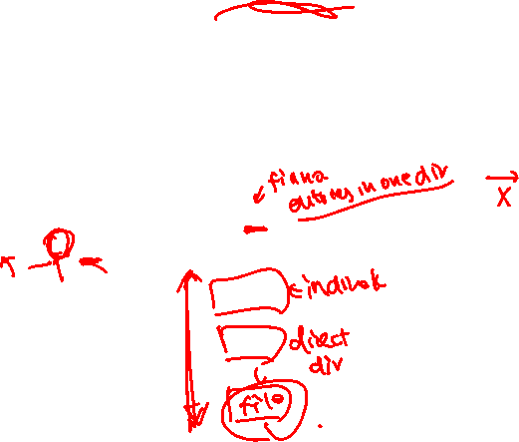
Q3e
Implement and optimize the storage and search of multiple fixed file sizes of 1MB. Each file has a unique numeric identifier, and it is saved on disk using ext2 file system.
The number of files is unlimited (say, 10 million), but it cannot grow beyond the disk size (maximum 10TB).
We want to optimize this file system to store and search fast for files by identifier.
You should use of some of the methods studies under file system implementation for your optimizations.
Explain how your suggestions (b, c, d) improve the storage and search times for a file. Estimate the overhead in terms of space and time of creating, maintaining, and using the additional data structures from point d.
Access time to a file depends on X and the number of indirect folders. The access time for a file is
X (log_{X}N + 1). If N=10 million, we can choose X to minimize the access time.

Slide 27
Q4

Slide 28
Q4a
In a particular ext2 filesystem, many data blocks belonging to different files have the same contents. We can implement a mechanism to reduce the space on disk occupied by such files.
Define a new system call, clone_file(), that makes a copy of a file without allocating new blocks on disk. Give the parameters, return value and description for clone_file(), and explain how to use the system call.

Slide 29

Q4a
In a particular ext2 filesystem, many data blocks belonging to different files have the same contents. We can implement a mechanism to reduce the space on disk occupied by such files.
Define a new system call, clone_file(), that makes a copy of a file without allocating new blocks on disk. Give the parameters, return value and description for clone_file(), and explain how to use the system call.
Many answers are possible. One possible answer is passing paths instead of FDs to the syscall.

Slide 30
Q4b
In a particular ext2 filesystem, many data blocks belonging to different files have the same contents. We can implement a mechanism to reduce the space on disk occupied by such files.
How would you allow for files that are cloned by clone_file to later be modified independently of each other? For example, if file A is cloned by clone_file to file B, and later on a write to file A is done, file B should still reflect the original contents. You should avoid duplication of blocks that are not yet modified.

Slide 31
Q4b
In a particular ext2 filesystem, many data blocks belonging to different files have the same contents. We can implement a mechanism to reduce the space on disk occupied by such files.
How would you allow for files that are cloned by clone_file to later be modified independently of each other? For example, if file A is cloned by clone_file to file B, and later on a write to file A is done, file B should still reflect the original contents. You should avoid duplication of blocks that are not yet modified.
Copy-on-write. The blocks should be marked as shared (detailed in part c), and then when those blocks are modified, a copy of the block should be made for the file through which the block is being modified.

Slide 32
Q4c
In a particular ext2 filesystem, many data blocks belonging to different files have the same contents. We can implement a mechanism to reduce the space on disk occupied by such files.
Explain how you would implement the mechanism in (b) in the ext2 filesystem. If changes to structures are required, explain those as well.

Slide 33

Q4c
In a particular ext2 filesystem, many data blocks belonging to different files have the same contents. We can implement a mechanism to reduce the space on disk occupied by such files.
Explain how you would implement the mechanism in (b) in the ext2 filesystem. If changes to structures are required, explain those as well.
We need to know which disk blocks are shared among multiple files. This info needs to be part of the group (partition) information in EXT2.
We can have a reference count for each block.
Or, we can have a ‘shared’ bit for each block. If a block that has the ‘shared’ bit set is written to, copy-on-write is done. However, some way to detect that a block is no longer shared is still needed.

Slide 34
Thank you!

